Slide 1
Flairdocs Workflow Designer Project
Demo 3
By the Null Pointers

Slide 2
Demo 3 Mission and Objectives
Finish Workflow Designer window functionality
Adding a reviewer to a step (by drag and drop)
Removing reviewer from a step
Deleting a step
Adding steps between steps

Slide 3

New Tools Used
JQuery UI: Drag and drop
(Not in final code) Dragula

Slide 4
Product Backlog
Stakeholder | Priority | Feature | Use Case | Points
Admin | 1 | Workflow Processing | Create a workflow | 21
Admin | 2 | Workflow Processing | Save a workflow | 13
Admin | 3 | Workflow Processing | Search for a workflow | 5
Admin | 4 | Workflow Processing | Open a workflow | 8
Admin | 5 | Workflow Designer Tool | Add a step to workflow | 21
Admin | 6 | Workflow Designer Tool | Add reviewer to step | 5
Admin | 7 | Workflow Designer Tool | Remove reviewer from step | 3
Admin | 8 | Workflow Designer Tool | Add step in between steps | 3
Admin | 9 | Workflow Designer Tool | Delete step | 3
Admin | 10 | Reviewer configurations | Set person as reviewer | 8
Admin | 11 | Reviewer configurations | Create actions for user role | 8
Admin | 12 | Reviewer configurations | Attach XML | 3
Admin | 13 | Reviewer configurations | Set prerequisites for reviewers | 5
Admin | 14 | Step configurations | Set requirement to advance to next step | 5

Slide 5
Demo 3 Requirement Traceability Matrix
Stakeholder | Priority | Feature | Objective | Size | Tests | Pass
Iteration 6: 11/3 - 11/10 (Planned: 8)
Admin | 5 | Workflow Designer Tool | Add reviewer to step | 5 | 0 | 0
Admin | 6 | Workflow Designer Tool | Remove reviewer from step | 3 | 0 | 0
Iteration 7: 11/10 - 11/17 (Planned: 6)
Admin | 7 | Workflow Designer Tool | Add step in between steps | 3 | 1 | 1
Admin | 8 | Workflow Designer Tool | Delete step | 3 | 1 | 1
Iteration 8: 11/17 - 11/24 (Planned: 8)
Admin | 9 | Reviewer configurations | Set person as reviewer | 8 | 0 | 0
Iteration 9: 11/24 - 12/1, Demo 3 (Planned: 0)
Admin |  | Documentation | Hardening iteration | 0 | 22 | 22

Slide 6
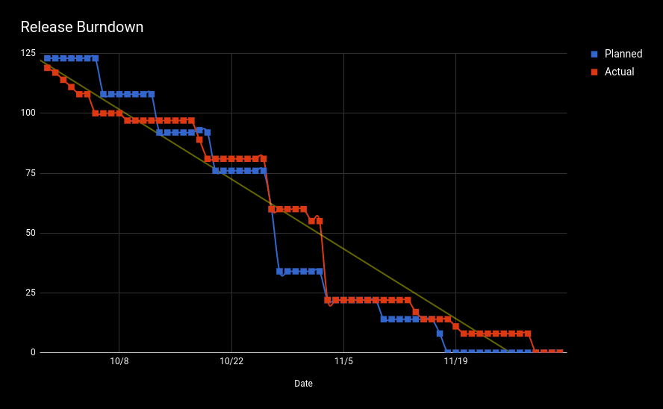
Release Burndown Chart

Slide 7
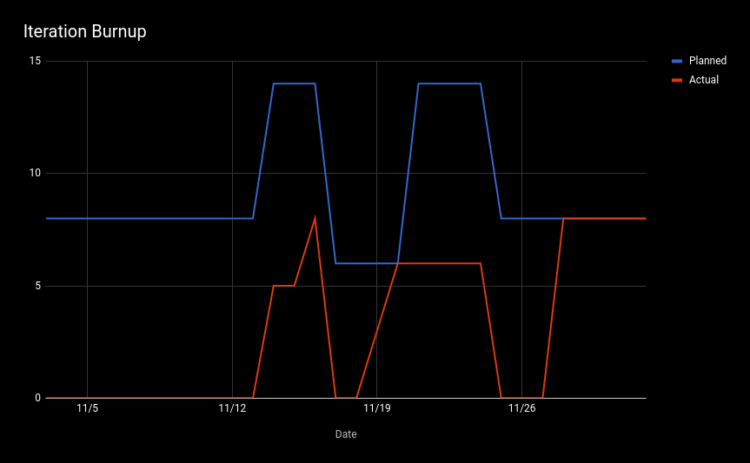
Demo Burnup Chart

Slide 8
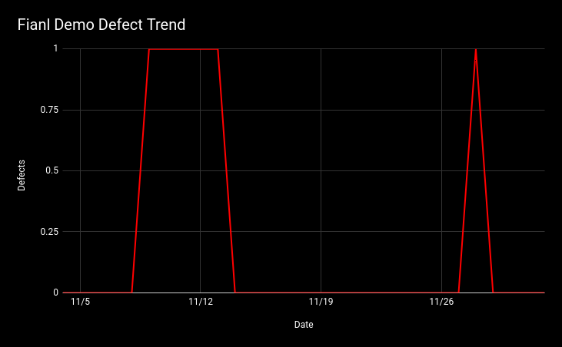
Defect Trend Chart
Drag and drop (double events)
Saving a reviewer changes the name

Slide 9
Regression Test Suite

Slide 10
Live Demo

